Slide 1


Lead Score Case Study
By Sandeep Suman Pradhan

Slide 2
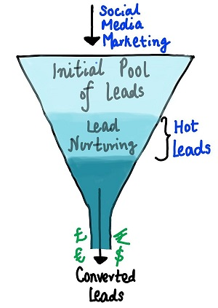
Problem Statement
X education sells online courses to industry professionals
The company markets its courses on several websites and search engines like Google. Once these people land on the website, they might browse the courses or fill up a form for the course or watch some videos. When these people fill up a form providing their email address or phone number, they are classified to be a lead
X education gets a lot of leads however the lead conversion is poor only about 30% of the leads get converted
To make this process more efficient, the company wishes to identify the most potential leads, also known as ‘Hot Leads’
If they successfully identify this set of leads, the lead conversion rate should go up and the sales team then would focus on converting the leads rather than focus on everyone
Business Objective:
X education wants to find out more promising lead such that the lead conversion is good (‘Hot Leads’)
For this purpose a model should be built that identifies ‘Hot Leads’
Relieve work effort of the sales team by deploying the model for future use to avoid calls to everyone

Slide 3
Solution Process
Data cleaning , understanding and manipulation
Handle duplicate data
Check and handle missing and nan values
Drop columns if they contain large amount of missing values which will not be useful for analysis
Impute values if required
Handle outliers if any
Exploratory Data Analysis(EDA)
Univariate Data Analysis
Bivariate Data analysis
Feature scaling and dummy variable encoding
Logistic regression used for model building and prediction
Validation of the model
Model presentation
Conclusion and Recommendation

Slide 4
Data Manipulation
Total number of rows=37, Total number of columns=9240
Columns with single unique values such as ‘Magazine',’ Receive More Updates About Our Courses’, 'Update me on Supply Chain Content’, 'Get updates on DM Content’, 'I agree to pay the amount through cheque’ were dropped as they add no value to the analysis
Removed ‘Prospect ID’ and ‘Lead number’ columns as they added no value to the analysis
Checked the value counts for some object type variables and decided to drop features with not enough variance such as ‘Do Not Call’ , ‘What matters most to you in choosing Course’, ‘Search’ , ‘Newspaper Article’, ‘X education Forums’, etc
Dropped columns with more than 35% missing values

Slide 5
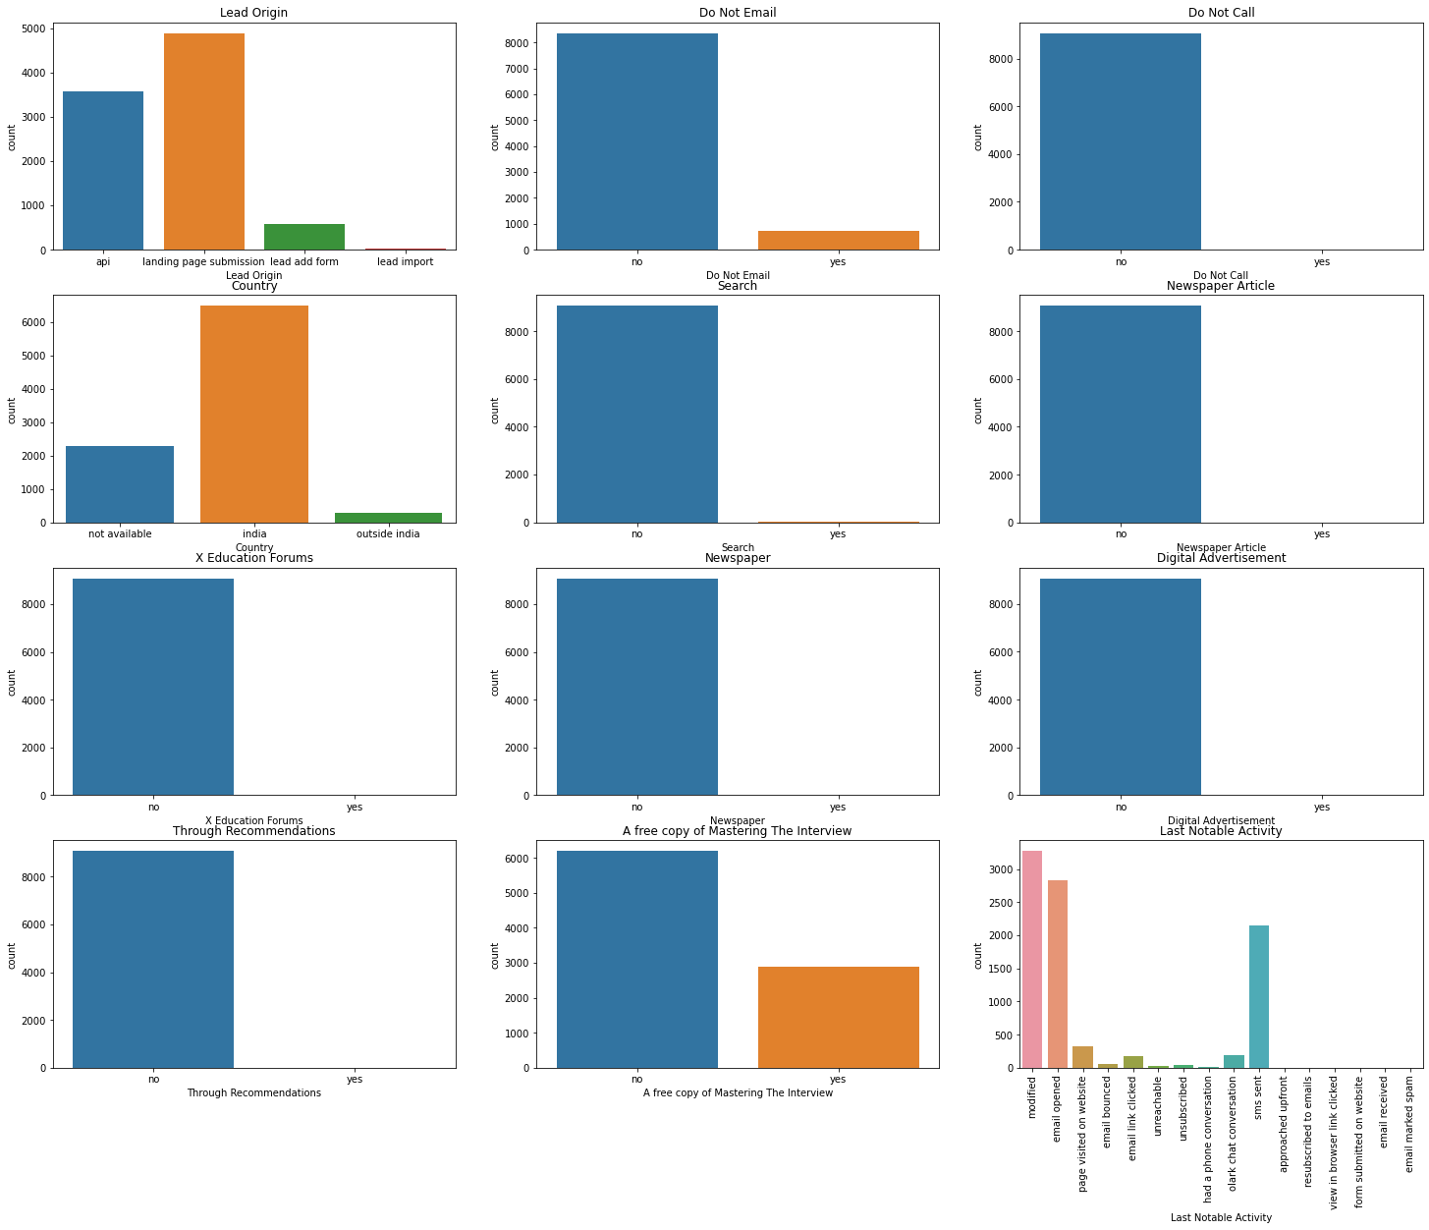
Exploratory Data Analysis(EDA)

Slide 6
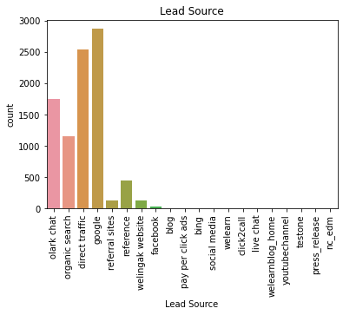
Exploratory Data Analysis(EDA)

Slide 7
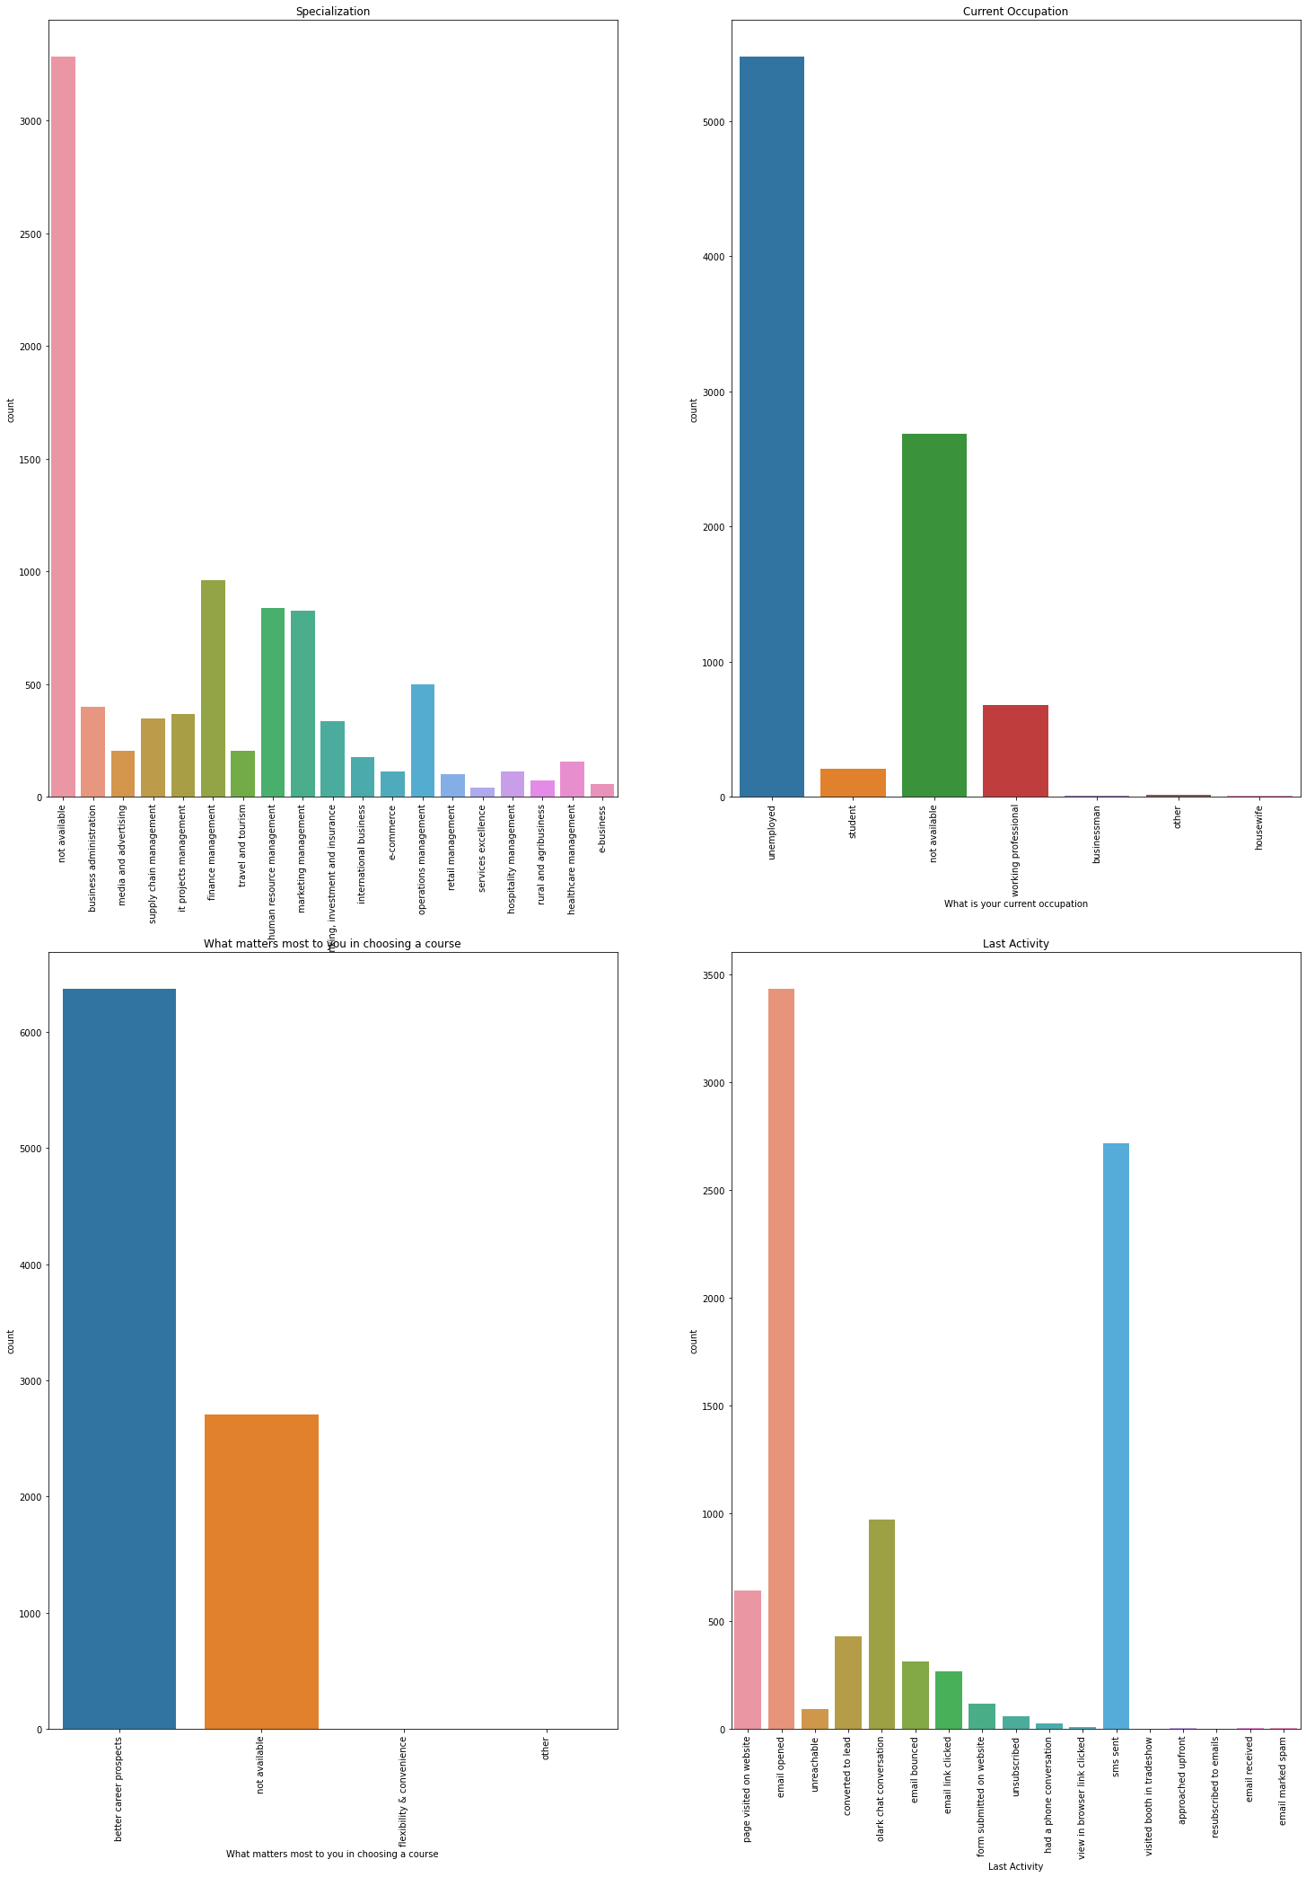
Exploratory Data Analysis(EDA)

Slide 8
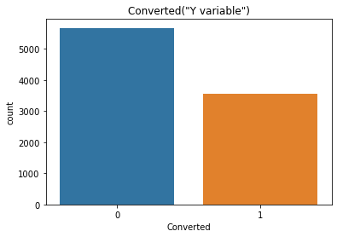
Exploratory Data Analysis(EDA)

Slide 9
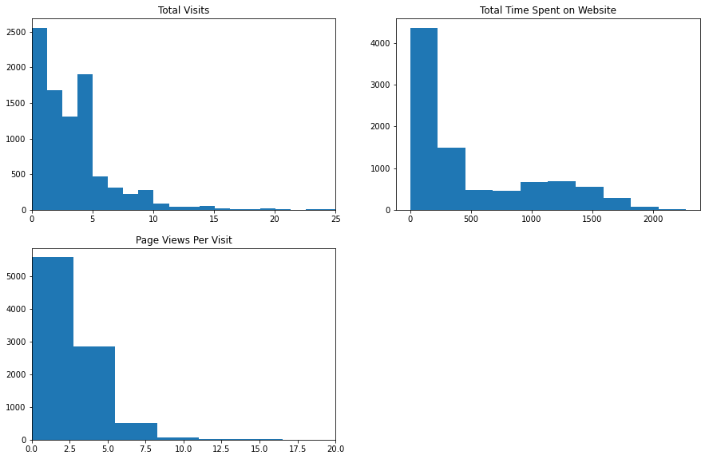
Exploratory Data Analysis(EDA)

Slide 10
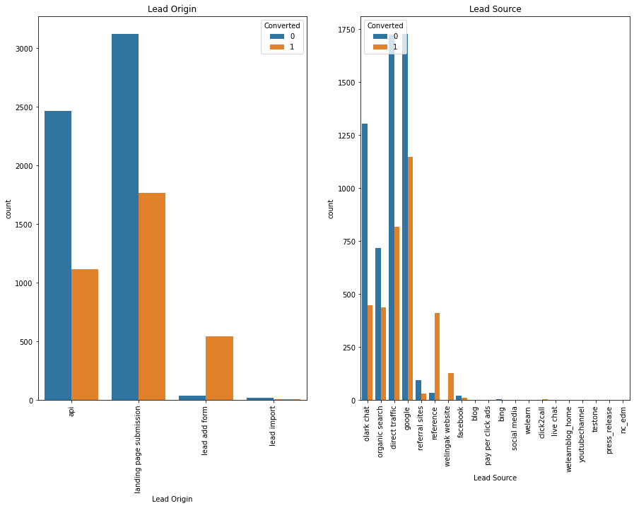
Exploratory Data Analysis(EDA)

Slide 11
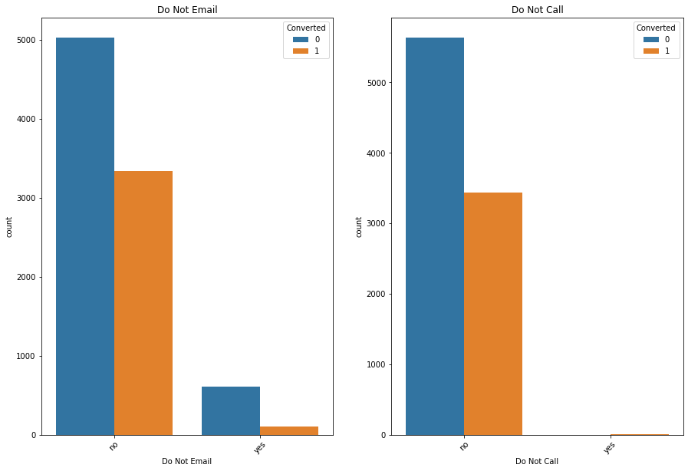
Exploratory Data Analysis(EDA)

Slide 12
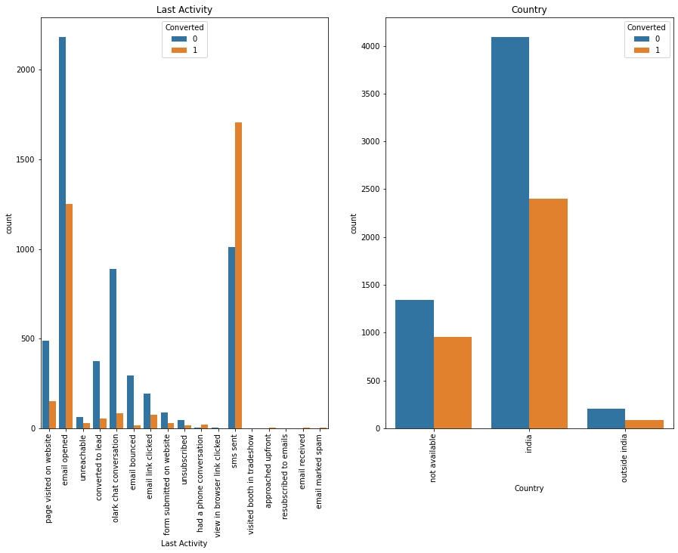
Exploratory Data Analysis(EDA)

Slide 13
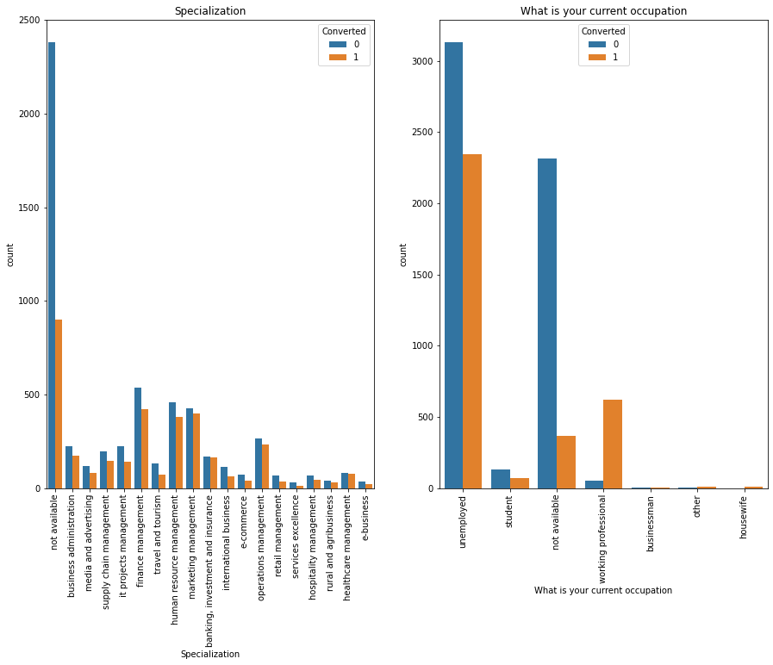
Exploratory Data Analysis(EDA)

Slide 14
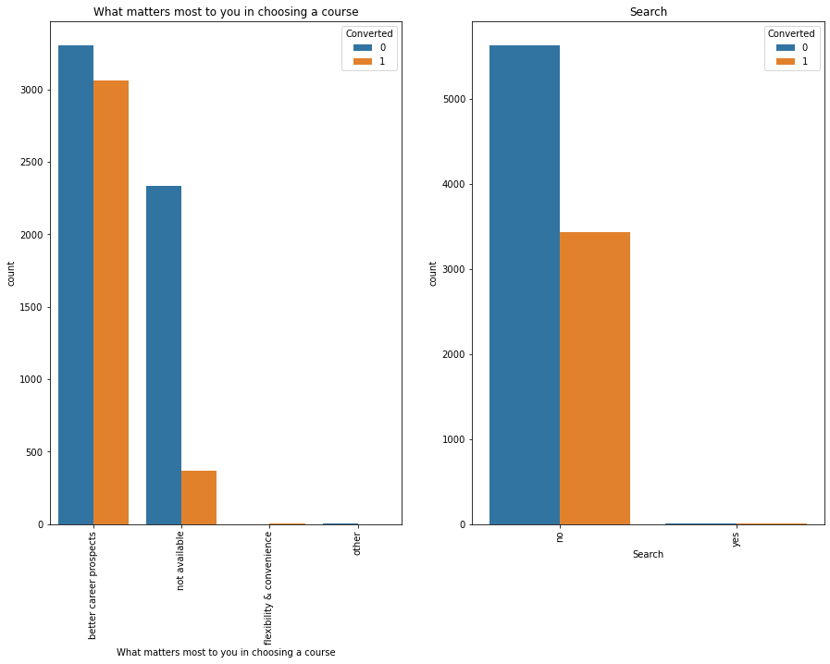
Exploratory Data Analysis(EDA)

Slide 15
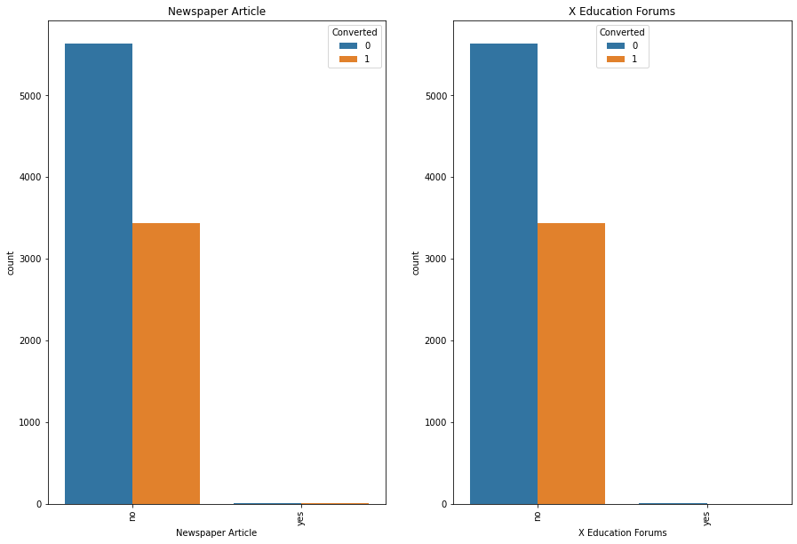
Exploratory Data Analysis(EDA)

Slide 16
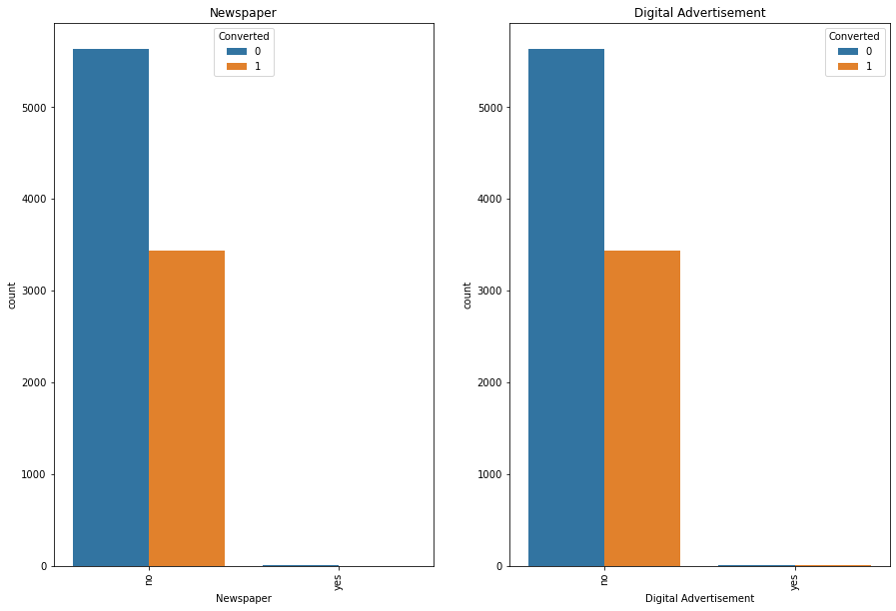
Exploratory Data Analysis(EDA)

Slide 17
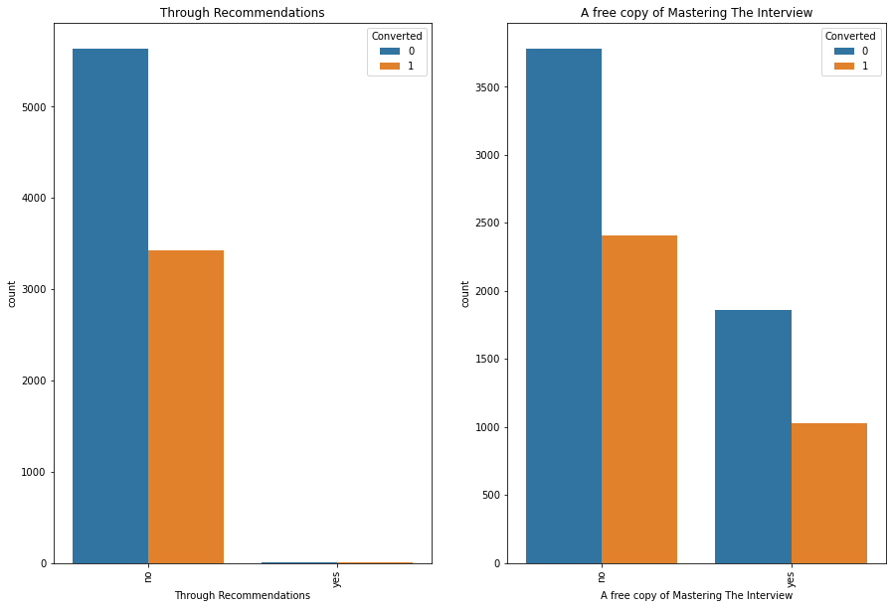
Exploratory Data Analysis(EDA)

Slide 18
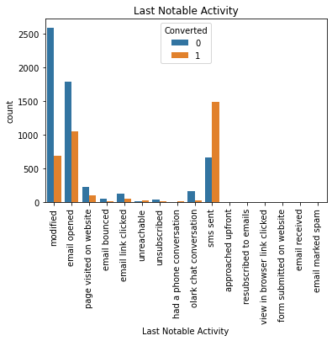
Exploratory Data Analysis(EDA)

Slide 19

Exploratory Data Analysis(EDA)

Slide 20
Data Conversion
Numerical variables were scaled and normalized
Dummy Variables were created for Object type variables
Total Rows for Analysis: 8792
Total columns for analysis: 43

Slide 21
Model Building
The data was split 70, 30 into train and test sets
The train and test split was performed using linear regression in a 70-30 ratio
Used RFE for feature selection
We ranked the features and chose most relevant 15 features through RFE
We built the models by removing features whose p-value was greater than 0.05 and VIF value was greater than 5
We did predictions on the Test data set
Overall Accuracy was 81%

Slide 22
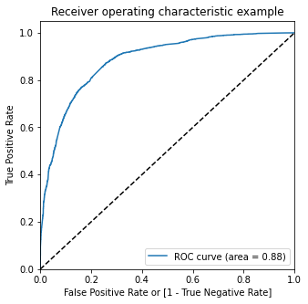
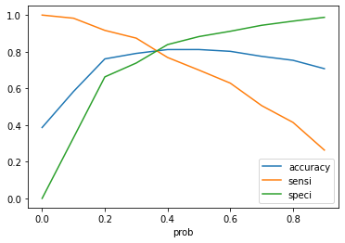
ROC Curve
We found the Optimal cut off point
Optimal cut off probability gives the point at which sensitivity and specificity intersect and are balanced
From the second graph it was found that the optimal cut off point was 0.38

Slide 23
Conclusion
The variables which mattered most to potential buyers were:
Total time spent on the website
Total number of visits
When the lead source was:
Google
Direct Traffic
Organic Search
Welingak wensite
When the last activity was:
SMS
Olark chat conversion
When the lead origin is lead add format
When they were working professional
X education should focus on these points in order to increase their lead conversion rate and spend less time on calling prospective buyers

